Slide 1
The Image of Nursing
Sandy Summers, RN, MSN, MPH
Founder, Executive Director
The Truth About Nursing
Co-author, Saving Lives: Why the Media’s Portrayal of Nurses Puts Us All At Risk

Slide 2

The Gap
There is a vast gap between what nurses really do and what the public thinks they do

Slide 3
Univ. of Michigan study
24% of people put “some trust” in information provided by celebrities such as Playboy Bunny Jenny McCarthy about the safety of vaccines
http://tinyurl.com/5vzbrka
April 26, 2011 TIME magazine

Slide 4
JWT Communications study
1800 kids (year 2000)
Knew about nurse’s love not professional life
Private school kids—nursing’s too lowly

Slide 5
University of Dundee study 2009
Nurses are “brainless sex-mad bimbos”
TV is discouraging bright kids from nursing

Slide 6
Effects of undervaluation
Nurses can’t teach
Nursing ignored
Health care denursified
Notes:
People ignore health advice, Physicians ignore nursing assessments and suggestions for intervention,
Denursified , shorter hospital stays, replacing RNs with techs, poor ratios

Slide 7
Effects of undervaluation
Dearth of federal funding for nursing
 | Nursing | Medicine
Residencies | $1 | $375
Research | $1 | $200
Education | $1 | $50

Slide 8
Do physicians do all the work that matters?
Notes:
Let’s see what they do…

Slide 9
Grey’s Anatomy
2005

Slide 10
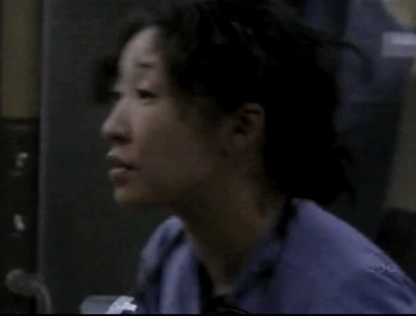

Slide 11
Grey’s Anatomy

Slide 12
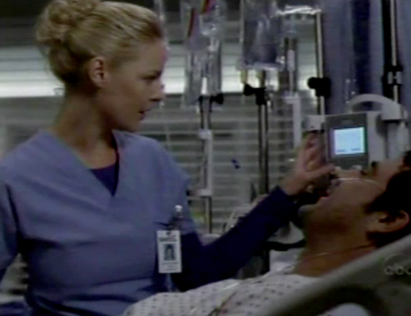
Notes:
No nurse would set an intern loose to deliver IV nitroglycerin

Slide 13
ER
Notes:
No nurse would set an intern loose to deliver IV nitroglycerin

Slide 14
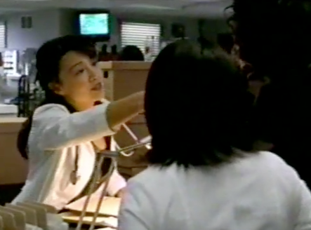

Slide 15
Physicians get all the thanks
Notes:
They get all the thanks for health care work

Slide 16
ER

Slide 17
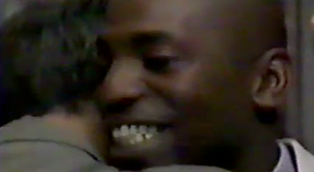
Notes:
They get the thanks because people assume they’re the only ones who have value

Slide 18
Other physician nursing
24/7 monitoring and surveillance
Psychosocial care
Notes:
People tell us if we want nurses on television, make a documentary. But nurses do at least half of the work television already finds dramatic, it’s just that the physicians are doing it.

Slide 19
Meanwhile, what do nurses do?

Slide 20
House
November 15, 2005

Slide 21
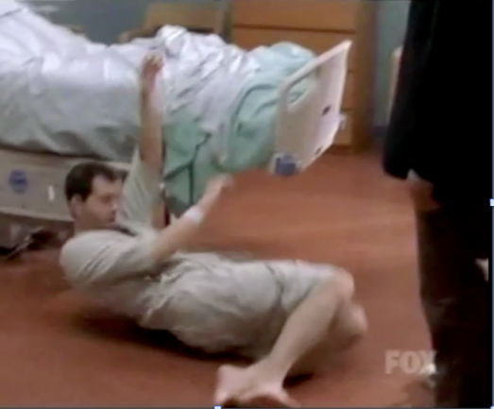

Slide 22
Are nurses skilled clinicians?

Slide 23
8 Simple Rules for Dating My Teenage Daughter
May 11, 2004

Slide 24
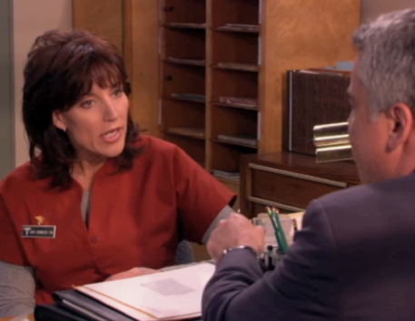
Notes:
Actually, they do die when nurses aren’t there

Slide 25
The idiot who has no empathy or idea how to help the patient

Slide 26
ER
Sept. 28, 2006

Slide 27
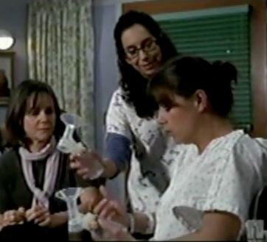

Slide 28
Grey’s Anatomy
The idiot, no independent thoughts
March 27, 2005

Slide 29
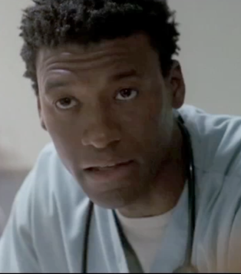
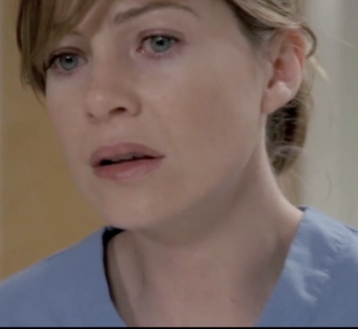

Slide 30
People who serve
Except on the new nurse shows, nurses don’t talk to each other or patients
Nurses first names
Physicians last names
Notes:
People who matter get last names. Servants get only first names.

Slide 31
As unskilled as …

Slide 32
Off the Map
(Shonda Rhimes’ product)
January 12, 2011

Slide 33
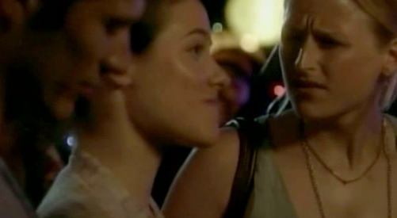

Slide 34
Royal Pains
June 4, 2009

Slide 35
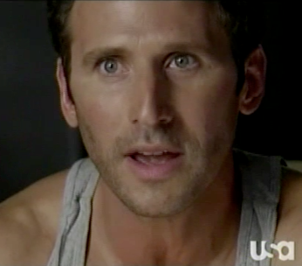

Slide 36
Bitter losers
Debbie
Tyler
Notes:
frustrated by the pretty smart people who actually make a difference

Slide 37
Nurses succeed by female intuition
Eli removing drains early to prevent infection
Bailey claims credit for the innovation through “science”

Slide 38
But really, who are nurses?
Autonomous professionals;
Educated and experienced clinicians, researchers, educators and advocates.

Slide 39
Skilled problem solvers
Detect problems;
Make decisions about how to resolve problems
Fix the problem themselves or--
Coordinate with the health care team to get the plan implemented.

Slide 40
Nurse Jackie
April 12, 2010

Slide 41
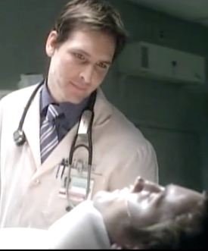
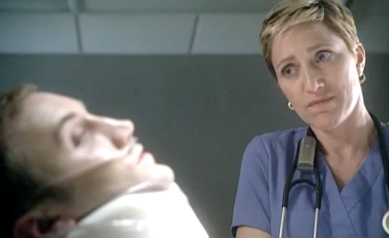

Slide 42
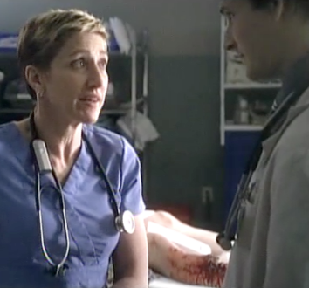
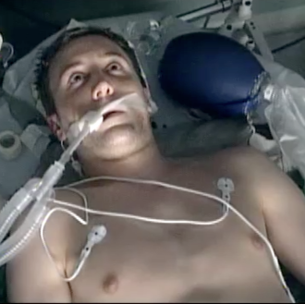

Slide 43
Nurse Jackie

Slide 44
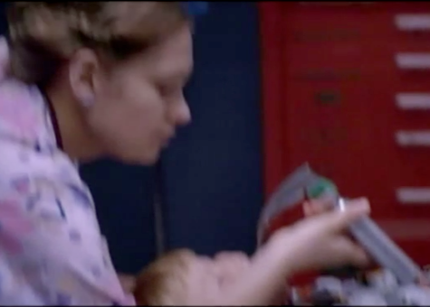
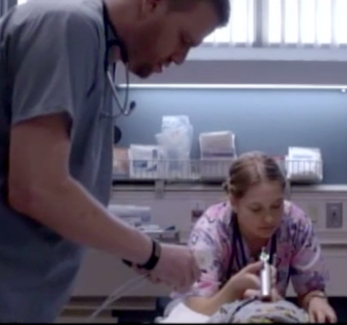

Slide 45
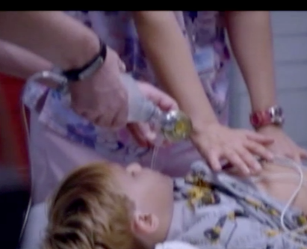
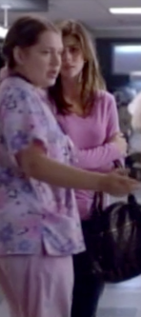

Slide 46
Why do hospitals exist?
Notes:
To provide nursing care

Slide 47
Nurses can talk to each other

Slide 48
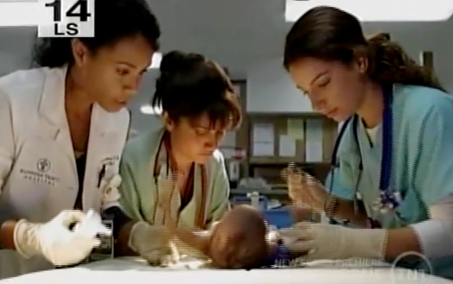

Slide 49
But, nurses actually have skill, courage and education

Slide 50
ER
October 2005

Slide 51
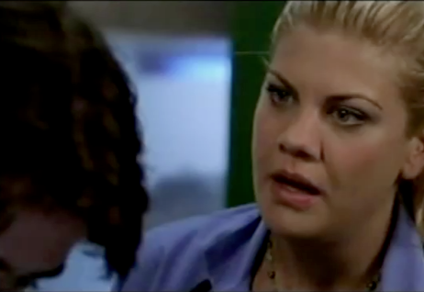
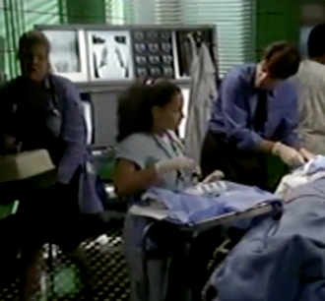

Slide 52
Nurses teach physicians
But it is rarely publicly recognized

Slide 53
ER
October 2005

Slide 54
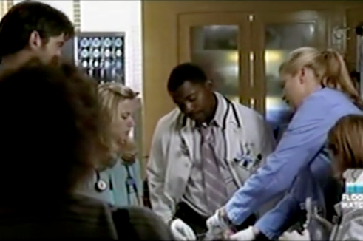
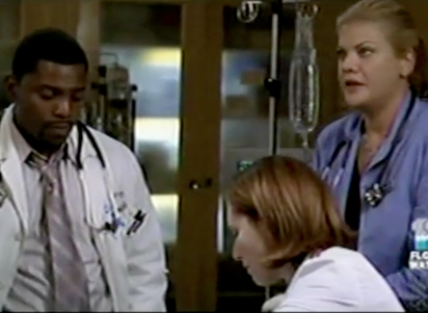

Slide 55
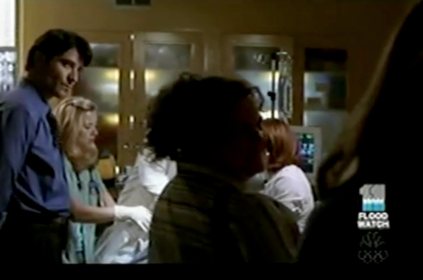
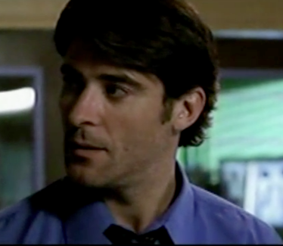

Slide 56
Autonomy
Notes:
Let’s talk about nursing autonomy. When we first started talking about this 10 years ago, even nursing scholars gave us pushback that nurses were autonomous. At least now nursing academics have embraced it, but it’s a challenge to get nurses in the clinical setting to think, talk and act like they are autonomous professionals.

Slide 57
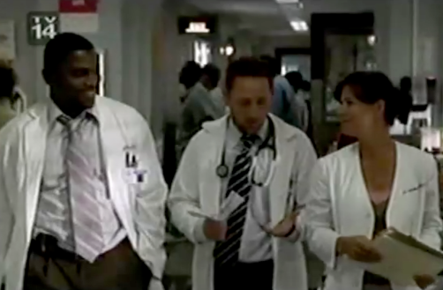
Notes:
We sent our analyses to ER for 4 years before they put these words in the show’s mouth. Unfortunately, words mean less than actions

Slide 58
Do patients “belong” to physicians?

Slide 59
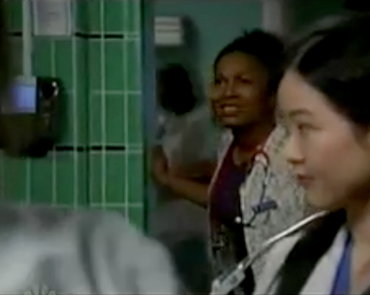
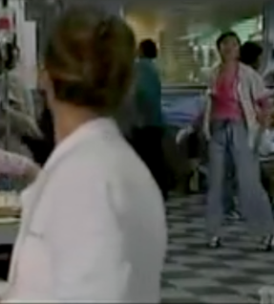
Notes:
Apparently so

Slide 60
Nurses apparently learn only from physicians, not nurses
Dell midwife training from Addison

Slide 61
Who hires, fires and
supervises nurses?

Slide 62
ER
Abby is a nurse in this scene

Slide 63
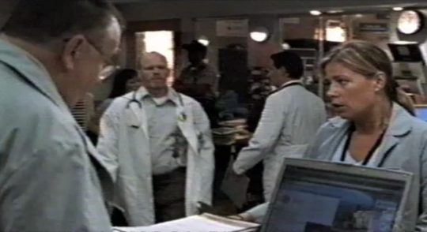
Notes:
No, physicians can’t hire fire or supervise nurses

Slide 64
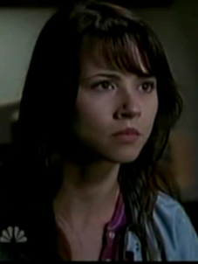
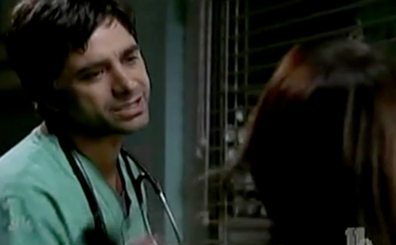
Notes:
Nurses have an independent legal and ethical duty to the patient to with physicians for a plan of care they think best for the patient. Nurses should take disagreements with physicians to the ethics committee. And aside from any nursing autonomy point, this plotline is an offense to nursing since nurses are almost never promote futilely keeping the patient alive.

Slide 65
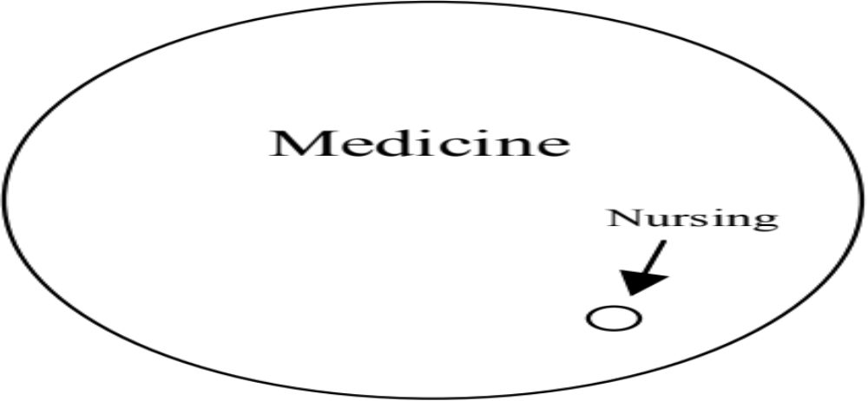
The public’s perception:
Nursing lacks autonomy, power and an independent knowledge base

Slide 66
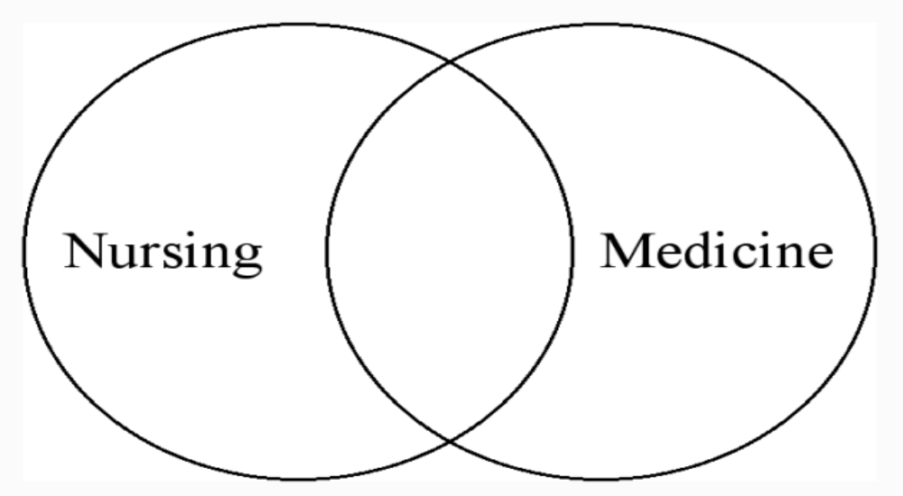
Reality: the knowledge bases

Slide 67
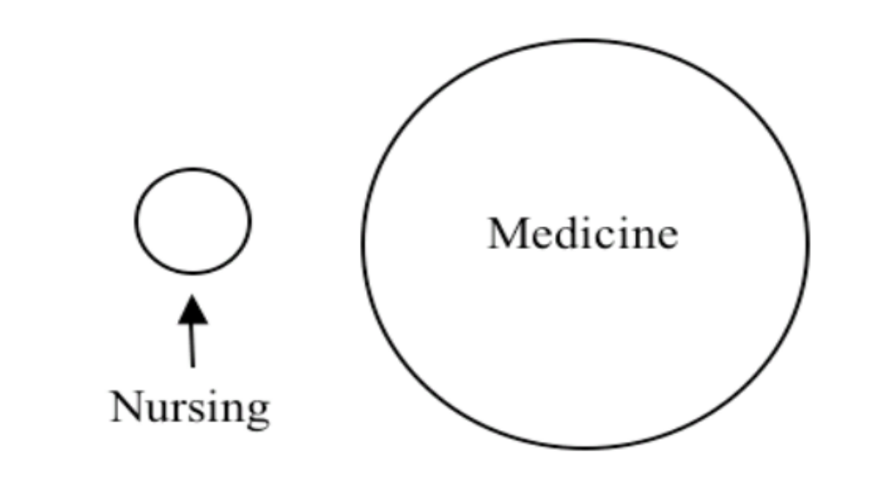
Reality:
Autonomy and Power

Slide 68
Nurses teach patients

Slide 69
Nurse Jackie
March 29, 2010

Slide 70
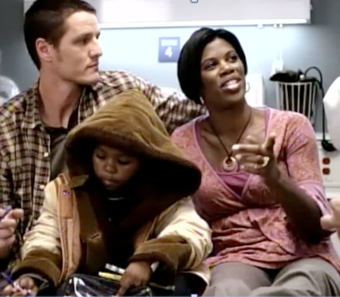
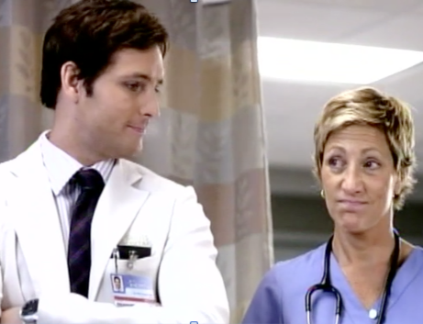
Notes:
Nurses verify that physicians do what they need to do

Slide 71
Nurses run codes autonomously

Slide 72
Nurse Jackie
Marcy 29, 2010

Slide 73
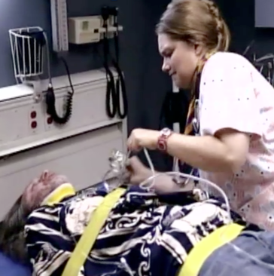
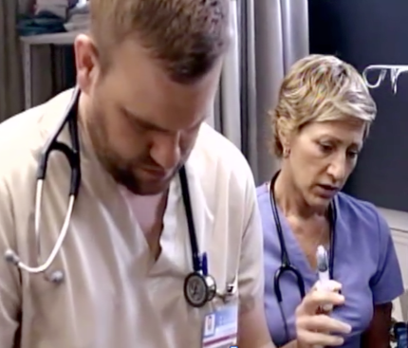

Slide 74
Nurses advocate autonomously

Slide 75
Mercy
November 18, 2009

Slide 76
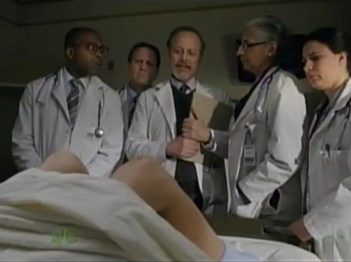
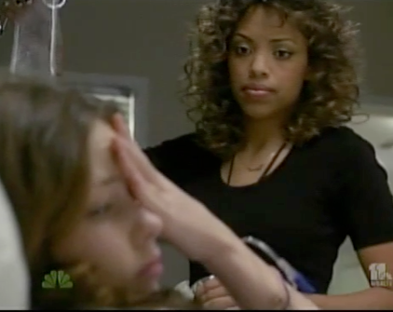

Slide 77
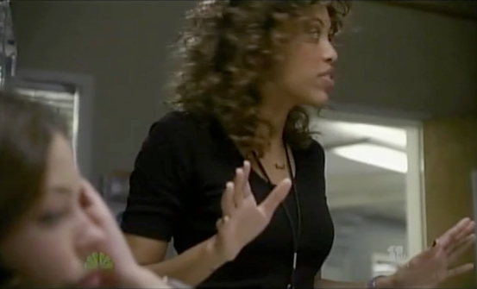

Slide 78
Naughty nurse
Grey’s Anatomy:
Nurses who “can’t keep their knees together”
Notes:
Arizona’s going away party, don’t bring lousy cupcakes like you would for a party for some nurse who couldn’t keep her knees together
Ballie lecturing nurses who wouldn’t work with Mark Sloane because he loved and left too many of them about not keeping knees together

Slide 79
Naughty nurse
House: Ranking nurses “in order of doability”
Desperate Housewives
Notes:
Desperate Housewives dressed up as naughty nurse to apply lotion to husband to treat case of pubic lice she had given him.

Slide 80
Grey’s Anatomy
The skanky syph nurse
December 11, 2005

Slide 81
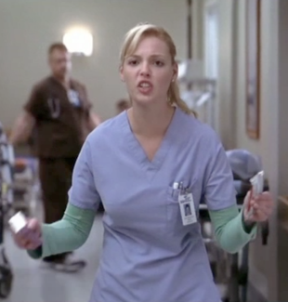

Slide 82
Tag Body Spray

Slide 83


Slide 84
Dentyne

Slide 85
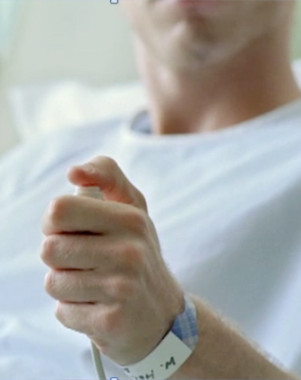
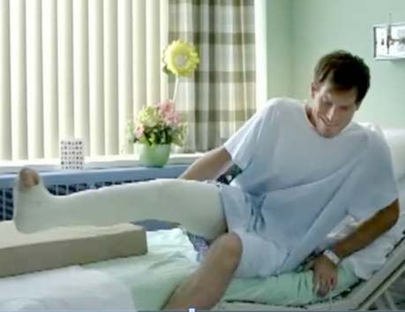

Slide 86
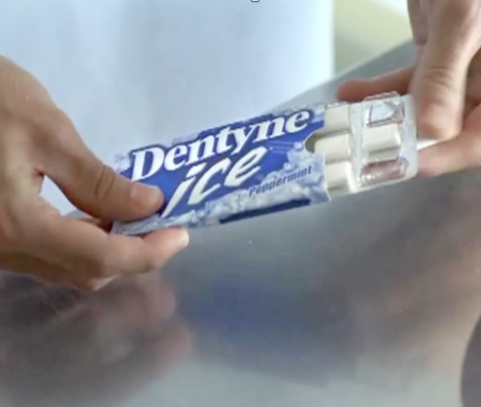
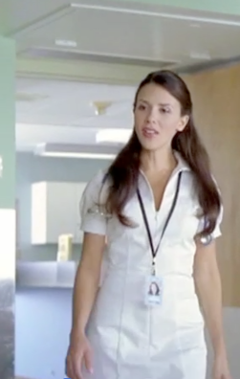

Slide 87
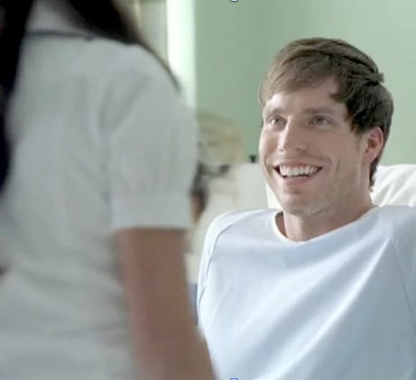
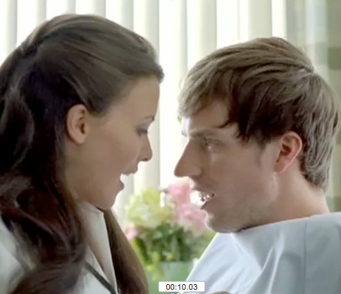

Slide 88
ER
The updated naughty nurse
Notes:
The updated naughty nurse: Nurses exist to have relationships exclusively with physicians.

Slide 89
Dr. Oz Show
November 4, 2010

Slide 90
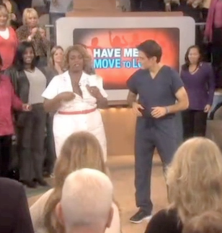

Notes:
He ran another show called “The Spice of Life” about 5 days after we started our letter-writing campaign. It wasn’t until we got the Associated Press to cover the story and it went global that he issued a half-hearted apology and now has the first nurse blogger on his website (among many physicians) and he’s had at least one nurse display her expertise on the show

Slide 91

Has seen lots of “cute little nurses” who are out to meet and marry” physicians because “that’s their ticket out of having to work as a nurse.”
November 2004

Slide 92
Who would want
to be a nurse?

Slide 93

Naughty nurse, “just a joke”?
Patient: “No sex act? I want you fired!”
Dutch Nurses campaign:
“We Draw the Line Here”
Notes:
Patient wanted nurse fired for refusal to perform sex act on patient. Jokes are how derogatory stereotypes are spread about a lot of groups. Demoralizes practicing and potential nurses, suggests it’s nurses’ jobs to provide sex, contributes to sexual harassment in the workplace and discourages self-respecting people, especially men, from coming into nursing.

Slide 94
Yesterday’s women?

Slide 95


Notes:
Carping old nurse knows nothing. Grey’s Anatomy’s pretty young smart women want nothing more than to differentiate themselves from nurses. To the show, nurses belong in the dustbin of history and to the extent nurses do appear on the show, it’s to contrast with the physicians to show just how far they’ve come, baby.

Slide 96


Notes:
Carping old nurse knows nothing. Grey’s Anatomy’s pretty young smart women want nothing more than to differentiate themselves from nurses. To the show, nurses belong in the dustbin of history and to the extent nurses do appear on the show, it’s to contrast with the physicians to show just how far they’ve come, baby.

Slide 97
Would any self-respecting person want to be a nurse?
Nursing care model
Save Lives
Improve quality of life, empower people
Notes:
Are the lives nurses save somehow of lesser value than the lives physicians save?

Slide 98
Wannabe physician
Dell on Private Practice
Ray on HawthoRNe
Abby and Carol Hathaway ER
Notes:
Dell, end UCLA med school, also pretending to be a physician
Ray on HawthoRNe did badly on MCATs

Slide 99
Men in nursing
You must be gay!
Couldn’t you hack medical school?
Notes:
I’m certainly happy to have gay or straight men in nursing, we have to find away to invite the straight men in.

Slide 100
Rizzoli & Isles
A real man’s man
Notes:
Dell, end UCLA med school, also pretending to be a physician
Ray on HawthoRNe did badly on MCATs

Slide 101


Notes:
Even EMTs get more respect

Slide 102
Private Practice
Dell the receptionist
Notes:
Rizzoli & Isles presented a male nurse wanted to become a stay at home dad and give up his job, The mockable receptionist and midwif

Slide 103

Notes:
assistant

Slide 104

Notes:
assistant

Slide 105

Notes:
assistant

Slide 106

Greg Focker
Notes:
Went from determined fighter, to 9th place finisher, to respected nurse manager

Slide 107

Peter Riggs: Boy toy
Strong Medicine
Notes:
Women look all that more powerful when they have someone else to boss around

Slide 108

Eli: Boy toy
Grey’s Anatomy
Notes:
Stronger the person you’re bossing around, the stronger it makes you look. Problem is that nurses are autonomous professionals and no one rightfully bosses us around.

Slide 109
Nurse Jackie
March 29, 2010

Slide 110


Slide 111
What’s wrong angel?
Notes:
Live in heaven
Perfect care of patients, never stop for a break, and frankly, a little intimidating, so scared to see how you actually save lives

Slide 112
Angel, attempts to repair offense
Regis & Kelly
Dr. Phil
Notes:
Regis heart surgery, Kelly his naughty nurse
Dr. Phil making amends, delivering unskilled angel-oriented praise
Attending physician Mark Sloane praises nurses as "helpful," "smart," and "already good at their jobs.”

Slide 113
Soft bigotry of low expectations
Mark Sloane praises nurses as "helpful," "smart," and "already good at their jobs.”
Notes:
How did they get that way? Do they go to school? Do nurses talk with and teach each other? You’d never know watching Grey’s

Slide 114
ER
Battleaxe obstructing life-saving heroic physicians
January 15, 2004

Slide 115


Slide 116



Slide 117
Nurses excel by going to med school?

Slide 118



Slide 119
Nurses who go to grad school?
100 x more likely to go to nursing grad school

Slide 120
The global effect of these images
Notes:
Brazilian professor. It is our civic duty to stop sending damaging images about nurses to the rest of the world

Slide 121
The effects
Lack of funding
Staffing ratios that drive nurses from the workplace
People die because they don’t value nursing health advice
Morale of the profession

Slide 122

How stereotypes undermine even the affected group

Slide 123

How stereotypes undermine even the affected group

Slide 124

How stereotypes undermine even the affected group

Slide 125

How stereotypes undermine even the affected group

Slide 126

How stereotypes undermine even the affected group

Slide 127

How stereotypes undermine even the affected group

Slide 128

How stereotypes undermine even the affected group

Slide 129

How stereotypes undermine even the affected group

Slide 130
But why bother, can we really make a difference?

Slide 131

Notes:
Fighting against negative images of gay people for decades

Slide 132



Notes:
Gay marriage efforts across many states have been successful because people are more open to gay people now, in large part because of the images we see in the media.

Slide 133


Notes:
Gay marriage efforts across many states have been successful because people are more open to gay people now, in large part because of the images we see in the media.

Slide 134



Slide 135
Repairing nursing’s image
Notes:
What do we need to do?

Slide 136
Repairing nursing’s image
Nurses who understand the media to act as advisors to shows, especially on scripts, where most of the trouble begins

Slide 137
Repairing nursing’s image
Nurse characters do nursing work

Slide 138
Words matter
Media creators should consider the effect of each word they say

Slide 139
Nurse-friendly language
“prescriptions” instead of “orders”
“physicians” instead of “doctors”
“health care” instead of “medicine”
“practice” instead of “work as a nurse”

Slide 140
Repairing nursing’s image
Media makers who take seriously the public health benefit of improving understanding of nursing
Notes:
It’s nice to tell stories about health care, it would kill you to try to teach people something about the value of nursing while you’re doing it.

Slide 141
Educate:
Media creators;
Nurses so they can educate the media;
Educate physicians so they don’t propagate untruths;
Create UCLA class on nursing and the media.

Slide 142
Repairing nursing’s image
Title parity: If I’m “Sandy,” You’re “Jim”; or
If you’re “Dr. Smith,” I’m “Nurse Summers”
(or “Dr. Summers” if I have my PhD)

Slide 143

Repairing nursing’s image
Speak!
Notes:
I often feel like the Lorax. I speak for the nurses because the nurses have no tongues.

Slide 144
Repairing nursing’s image
Don’t just tell stories about patients. Tell stories about nurses improving or saving lives.

Slide 145
Repairing nursing’s image
The Truth About Nursing’s action page
TruthAboutNursing.org/action/
Notes:
I often feel like the Lorax. I speak for the nurses because the nurses have no tongues.

Slide 146

Notes:
Educate the public that nurses save lives

Slide 147
We don’t need more images like this one

Slide 148
ER
(Abby is a nurse here)
April 25, 2011

Slide 149



Slide 150



Slide 151
We need images like this

Slide 152
Nurse Jackie
April 25, 2011

Slide 153



Slide 154



Slide 155



Slide 156



Slide 157



Slide 158


